Slide 1

Scrutiny

Slide 2

Problem statement
Using AI/ML Models on data taken from Social Media, Contact centers and Feedback surveys, develop a prototype that improves Customer Experience to result in high customer satisfaction and loyalty

Slide 3
Need for ANALYSIS
To say that customer satisfaction is important is an understatement. In 2023, it’s a necessity. According to Gartner, 81% of marketers view customer satisfaction as the main competition area in their industry.
But the competitive edge is not all. According to PwC 59% of customers will leave a company after several bad experiences, and 17% after one bad customer experience

Slide 4
Solution
Detailed interactive dashboard with an in-depth analysis of real world CBRE Data
Advanced Sentiment analyzer tools and Machine Learning classifiers deployed to determine nature of feedback
Effective in handling duplicate reviews or reviews from the invalid sources.
Points out commonly raised issues in the form of tags
Identifies region-wise reviews and high performing agents

Slide 5



Sentiment Analysis using NLP
Data Cleaning and Manipulation
Report Genration
Removing duplicates using K-means Clustering
Used TextBlob to find the nature of review
Found most common issues and tagged them
Generates a report containing as summary of the analysis and actionable
Dashboarding
Data Accumulation
Determining KPIs
Web-Scraping from social media websites, customer feedback and surveys​
Designing and formulating relevant KPIs such as NPS, CSAT etc.
Interactive dashboard using metrics to assess the overall nature of feedback built using JavaScript

Slide 6

Current version/prototype
Web Scraping of real world CBRE reviews on Trustpilot, Clutch and similar sites
Data Processing
Line Graph - CSAT vs Time
Bar Graph - All KPIs
Pie Chart – Nature and Distribution of data
Map – Region-wise data and sentiment

Slide 7
Box plot
Cost
Home
Worth
FHA
Neighbourhood
Realtor

Slide 8












ML MODEL
KPIs
Other Data
Bag of Words
Data
Preprocessing
K-Means
Agent
Sentiment

Slide 9
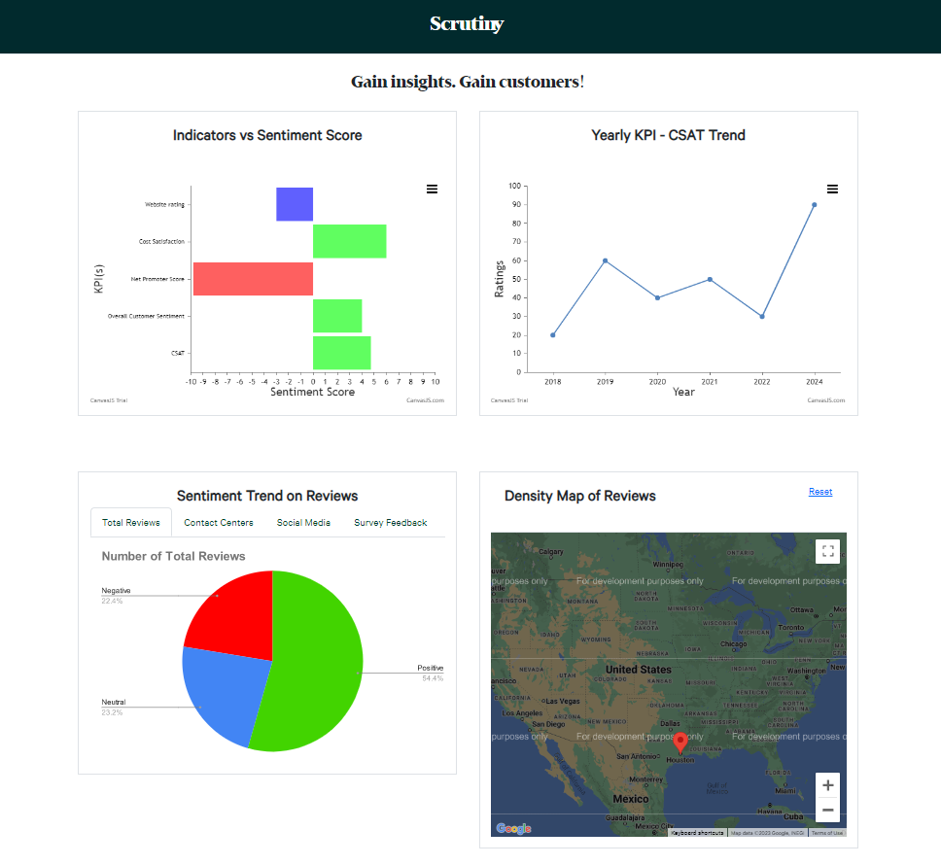
Current version

Slide 10
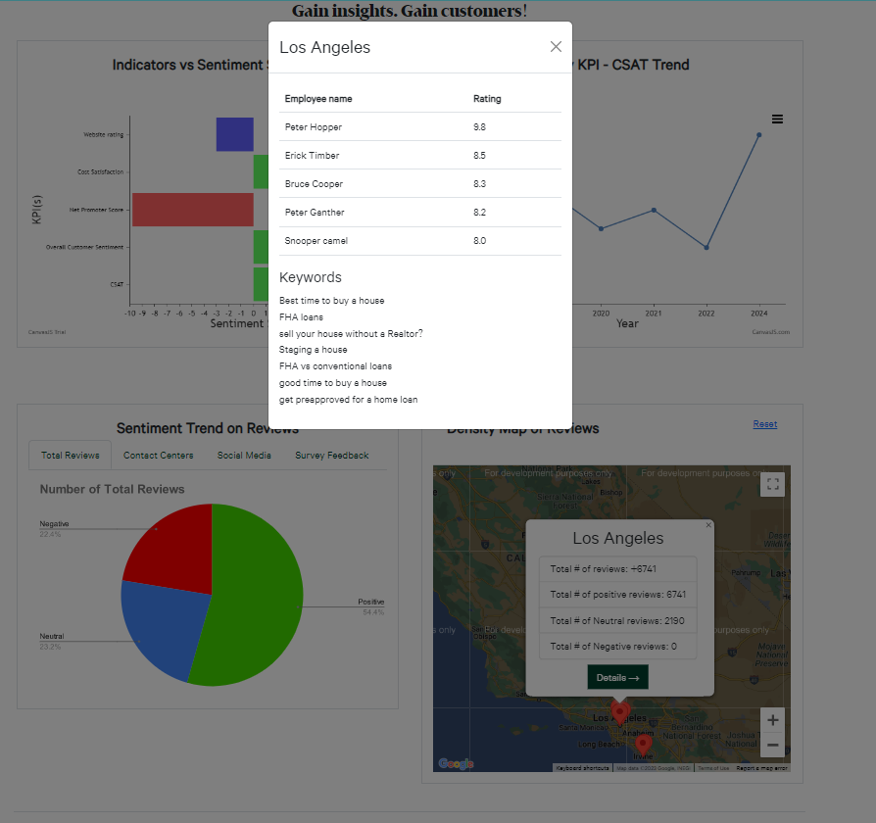
Current version

Slide 11
Recommendations based on current analysis
Cost satisfaction could be improved – observed negative / neutral sentiment
Agent Performance information – Find best agent in your area only by hovering
Inconsistent CSAT score – Work towards maintaining stability

Slide 12
Future vision
To facilitate its working with real time dynamic data
Improving Dashboard reports by drilling down and making to more issue focused
Applying more robust models such as BERT for Sentiment Analysis
Identification of public platform-based data sources for future references

Slide 13
THANK YOU!
Questions?

